Slide 1


PRACTICE
WHAT WILL THE CODE A & B PRINT?
5 MIN
INDIV
x = 10
if x > 4:
print("A")
elif x > 2:
print("B")
x =10
if x > 4:
print("A")
else :
if x > 2:
print("B")
A
B
>
>

Slide 2
PRACTICE
WHAT WILL THE CODE PRINT?
5 MIN
INDIV
X = 3
if x > 4:
print("A")
elif x > 2:
print("B")
>

Slide 3
PRACTICE
WHAT WILL THE CODE PRINT?
5 MIN
INDIV
x = 1
if x > 4:
print("A")
elif x > 2:
print("B")
>

Slide 4
PRACTICE
WHAT WILL THE CODE PRINT?
5 MIN
INDIV
x = 7
if x > 4:
print(“A")
if x > 2:
print(“B")
>

Slide 5

QUIZ
What are the possible
values of isGreater ?
5 MIN
CLASS
x = 6
isGreater = x > 5
if (isGreater == True) :
print (“python”)

Slide 6
QUIZ
5 MIN
CLASS
x = 6
isGreater = x > 5 or x < 10
if (isGreater == True) :
print (“python”)

Slide 7
QUIZ
5 MIN
CLASS
x = 10
isGreater = x > 9
if (isGreater) :
print (“python”)

Slide 8
EXPLAIN
Boolean value
5 MIN
CLASS
A boolean is a value that can be only
True or False

Slide 9
QUIZ
What is the difference between
the 2 codes
5 MIN
CLASS
x = 6
isGreater = x > 5
if (isGreater == True) :
print (“python”)
x = 6
isGreater = x > 5
if (isGreater) :
print (“python”)
A
B
C
Same Same
Different
I don’t know

Slide 10

EXPLAIN
A variable’s value
can be of different types
5 MIN
CLASS
integer
decimal
Type | Possible values
Number | 1 , 3, 4.58
Boolean | True, False
My type of value is number
My type of value
is boolean
3
True
Uppercases !!
BOB
BIBI

Slide 11
QUIZ
What is the difference between
the 2 lines of code?
5 MIN
CLASS
X = 5
X == 5
A
B
C
Same Same
Different
And I know
Different
But I don’t know

Slide 12
EXPLAIN
Boolean expression
1 MIN
CLASS
A Boolean expression is a composition of Boolean values using or/and/not operators

Slide 13
QUIZ
What will be the value of BOB?
5 MIN
CLASS
X > 5
True
X = 0
Y = 4
Z = 5
OR
BOB
A
B
C
True
False
I don’t know

Slide 14
QUIZ
What will be the value of BOB?
5 MIN
CLASS
X > 5
Z > Y
X = 0
Y = 4
Z = 5
AND
X < 1
OR
BOB
A
B
C
True
False
I don’t know

Slide 15
QUIZ
Write this code in python on paper
5 MIN
CLASS
X > 5
Z > Y
AND
X < 1
OR
BOB

Slide 16
QUIZ
WHAT WILL THE CODE PRINT?
5 MIN
CLASS
x = 13
print ( x > 7 or (x > 2 and x < 6))
>

Slide 17
QUIZ
WHAT WILL THE CODE PRINT?
5 MIN
CLASS
x = - 5
print ( x > 7 or (x > 2 and x < 6))
>

Slide 18
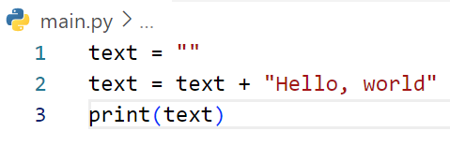
What is output of cod below?

Slide 19
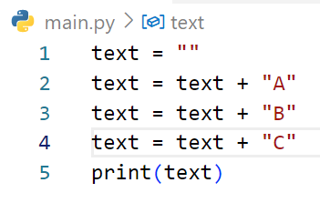
What is output of cod below?

Slide 20
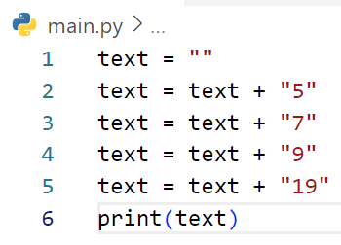
What is output of cod below?

Slide 21
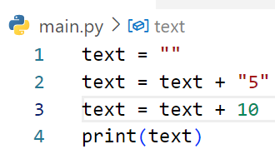
What is output of cod below?

Slide 22
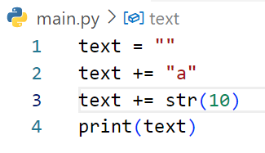
What is output of cod below?

Slide 23
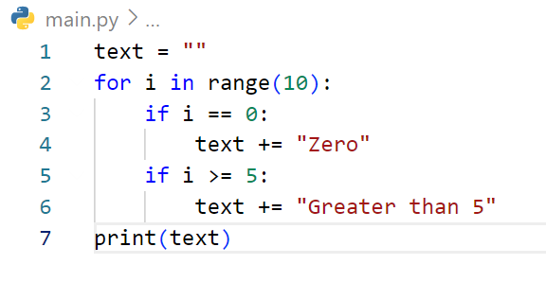
What is output of cod below?

Slide 24
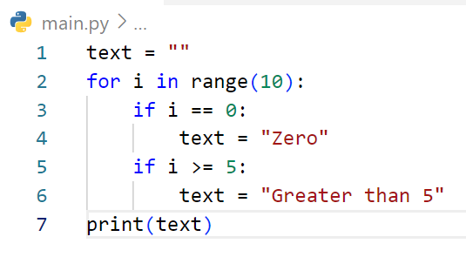
What is output of cod below?

Slide 25
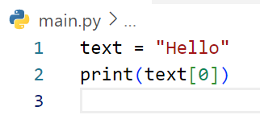
What is output of cod below?

Slide 26
What is output of cod below?

Slide 27
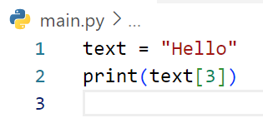
What is output of cod below?

Slide 28
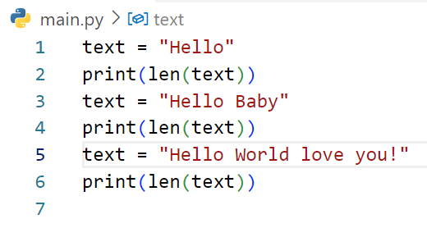
What is output of cod below?

Slide 29
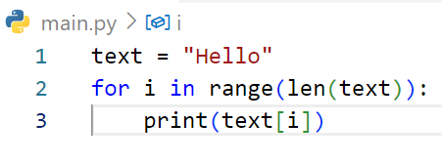
What is output of cod below?

Slide 30
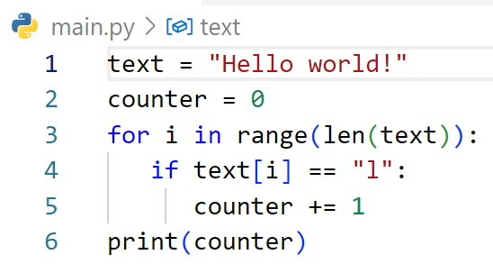
What is output of cod below?

Slide 31
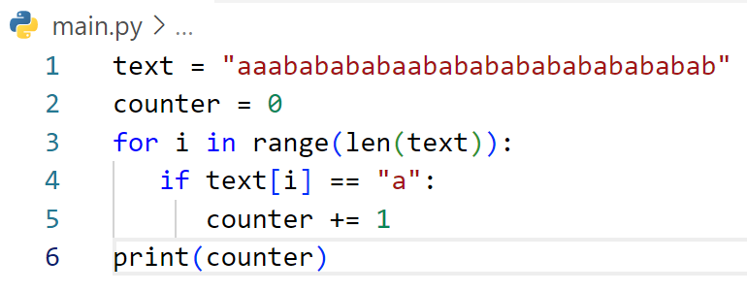
What is output of cod below?

Slide 32
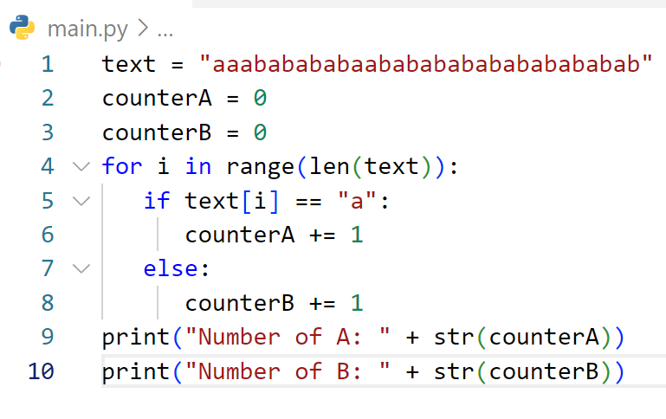
What is output of cod below?

Slide 33
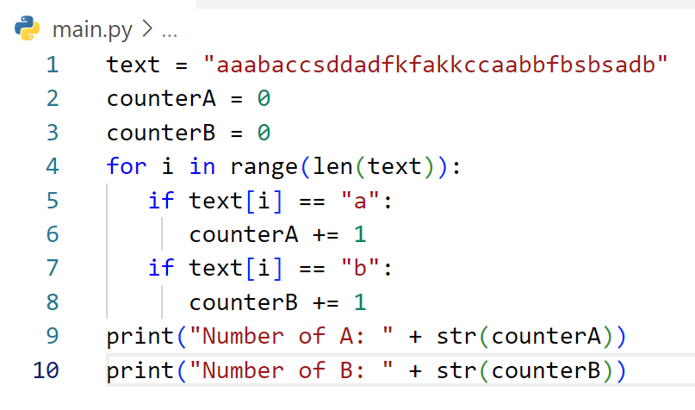
What is output of cod below?

Slide 34
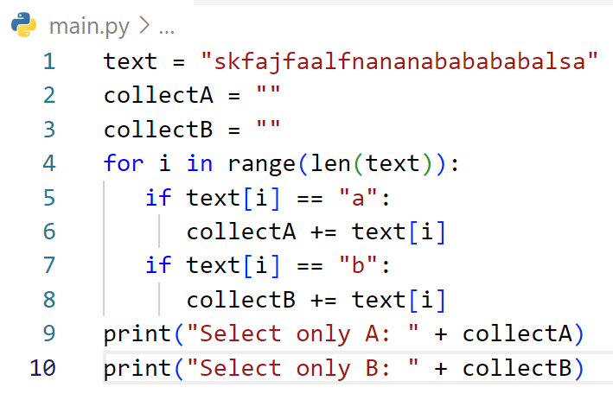
What is output of cod below?

Slide 35
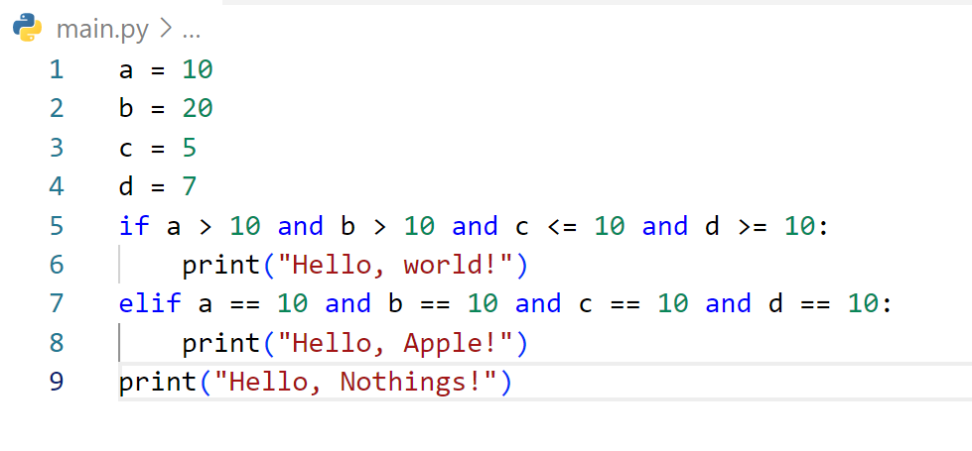
What is output of cod below?

Slide 36
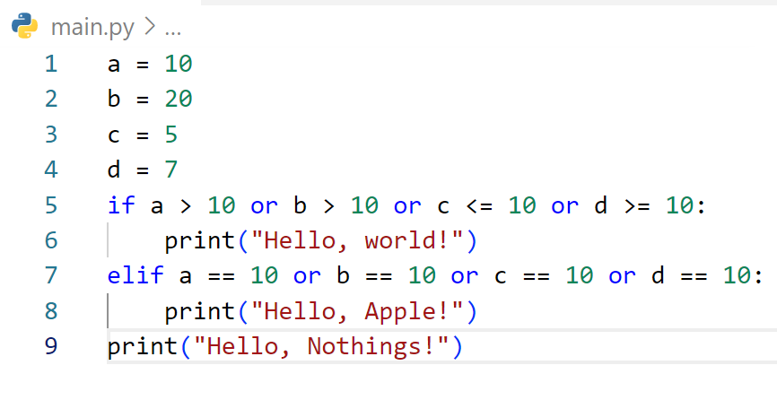
What is output of cod below?

Slide 37
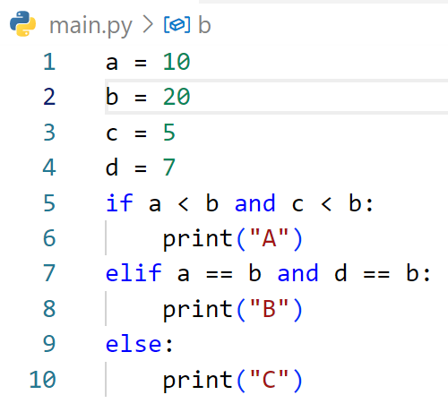
What is output of cod below?

Slide 38
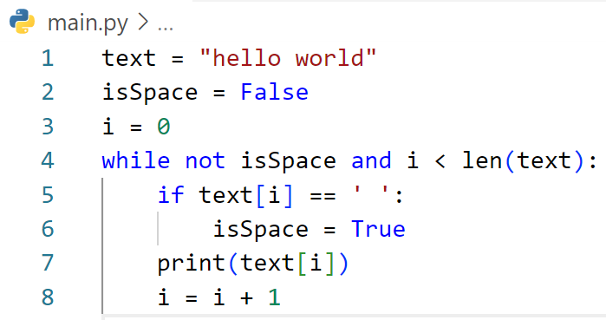
What is output of cod below?

Slide 39
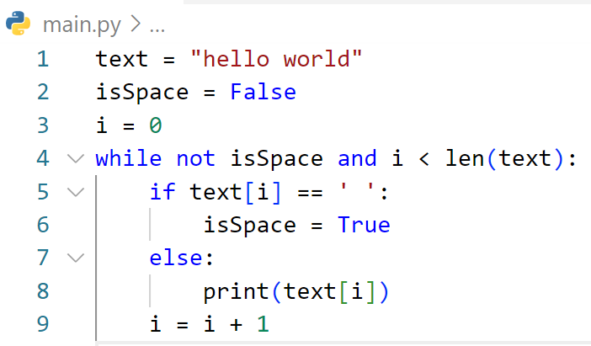
What is output of cod below?

